Slide 1




“Project Build Tool- MAVEN”
Introduction to MAVEN

Slide 2

Contents
What are build tools?
Understanding the problem without Maven
What Maven does?
Installation
POM
Maven Repository
Examples

Slide 3
What are build tools?
Build tools are programs that automate the creation of executable applications from source code (e.g., .apk for an Android app).
Building incorporates compiling, linking and packaging the code into a usable or executable form.

Slide 4
What are build tools?
In small projects, developers will often manually invoke the build process.
This is not practical for larger projects, where it is very hard to keep track of what needs to be built, in what sequence and what dependencies there are in the building process.
Using an automation tool allows the build process to be more consistent.

Slide 5
What are build tools?
Basically build automation is the act of scripting or automating a wide variety of tasks that software developers do in their day-to-day activities like:
Downloading dependencies.
Compiling source code into binary code.
Packaging that binary code.
Running tests.
Deployment to production systems.

Slide 6

Understanding the problem without Maven
There are many problems that we face during the project development without maven:
1) Adding set of Jars in each project: In case of struts, spring, hibernate frameworks, we need to add set of jar files in each project. It must include all the dependencies of jars also.
2) Creating the right project structure: We must create the right project structure in servlet, struts etc, otherwise it will not be executed.

Slide 7
Understanding the problem without Maven
3) Building and Deploying the project: We must have to build and deploy the project so that it may work.

Slide 8
What Maven Does?
Maven simplifies the above mentioned problems. It does mainly following tasks.
It makes a project easy to build
It provides uniform build process (maven project can be shared by all the maven projects)
It provides project information (log document, cross referenced sources, mailing list, dependency list, unit test reports etc.)
It is easy to migrate for new features of Maven

Slide 9
Installation
To install maven on windows, you need to perform following steps:
Download maven and extract it
Add JAVA_HOME and MAVEN_HOME in environment variable
Add maven path in environment variable
Verify Maven mvn −version

Slide 10
Maven pom.xml file
POM is an acronym for Project Object Model.
The pom.xml file contains information of project and configuration information for the maven to build the project such as dependencies, build directory, source directory, test source directory, plugin, goals etc.
Maven reads the pom.xml file, then executes the goal.

Slide 11
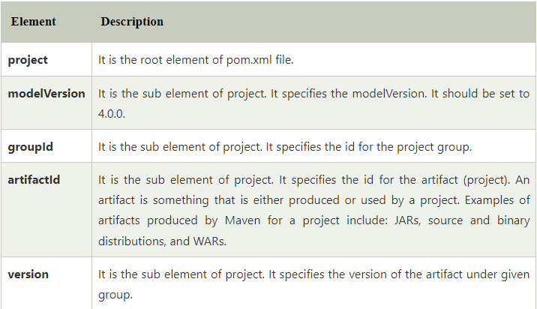
Maven pom.xml file
For creating the simple pom.xml file, you need to have following elements:

Slide 12
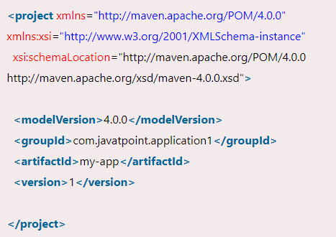
Maven pom.xml file

Slide 13
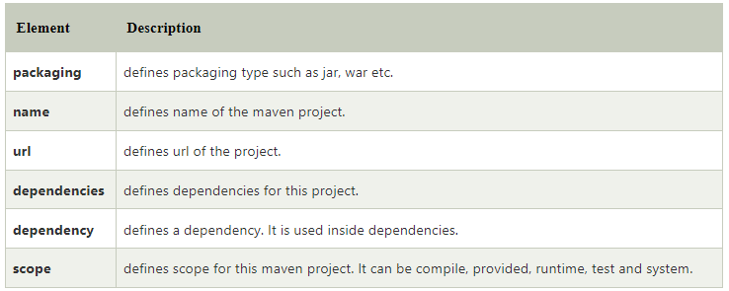
Maven pom.xml file
Other elements in pom.xml

Slide 14
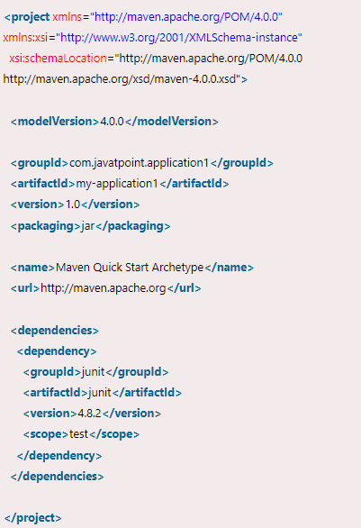
Maven pom.xml file

Slide 15
Thank You

